Slide 1
Preparatory Bridge Course
On Python and Data Science Libraries

Slide 2
Python

Slide 3
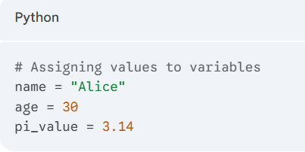
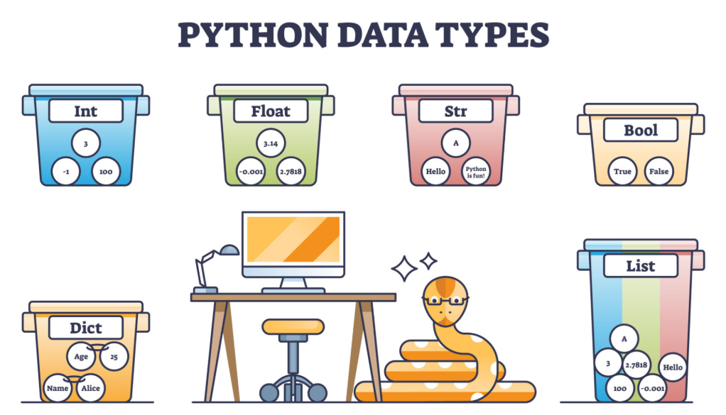
Variables and Common Data Types
What are variables? Think of them as labeled boxes or containers for storing data.
Assigning values: You use the equals sign (=) to assign a value to a variable.
Naming rules:
  Must start with a letter or underscore (_).
  Can contain letters, numbers, and underscores.
  Are case-sensitive (age is different from Age).

Slide 4
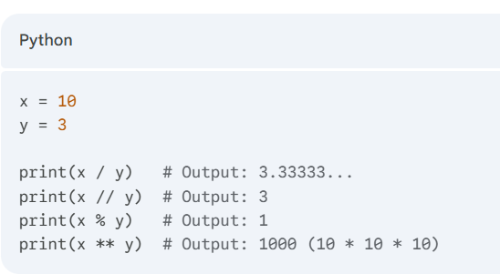
Arithmetic Operators
Key Operators:
  + : Addition
  - : Subtraction
  * : Multiplication
  / : Division (always results in a float)
  //: Floor Division (rounds down to the nearest whole number)
  % : Modulus (gives the remainder of a division)
  **: Exponent (to the power of)

Slide 5
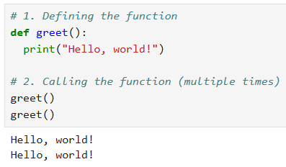
Defining & Calling Functions
What is a function?
A reusable block of code that performs a specific task. Think of it as a recipe.
Defining a function:
Uses the def keyword.
Followed by a function name, parentheses (), and a colon :.
The code inside the function must be indented.
Calling a function:
You "call" it by writing its name followed by parentheses ().

Slide 6
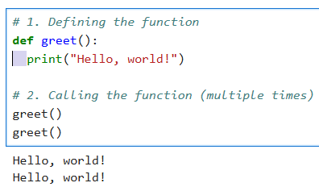
Python Indentation
What is Indentation?
  It's the whitespace (spaces or tabs) at the beginning of a line.
Why is it VITAL in Python?
  Unlike other languages that use curly braces { }, Python uses indentation to define code blocks.
  It tells Python what code "belongs" inside a function, an if statement, or a loop.
The Rules:
  Be consistent! Lines at the same level of a block must have the same indentation.
  You will get an IndentationError if it's wrong.

Slide 7
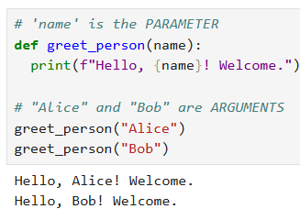
Parameters and Arguments
Parameter:
The variable listed inside the parentheses when defining the function.
It's a placeholder, like a blank in a form.
Argument:
The actual value you send to the function when you call it.
It's the information you write in the blank.

Slide 8
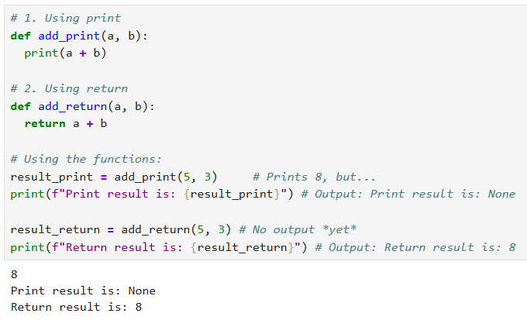
print vs. return
This is about how a function sends information out.
print()
  What it does: Displays a value to the screen.
  Key idea: The function itself does not give back a value you can store or use. It's a "dead end" for data.
return
  What it does: Sends a value back from the function.
  Key idea: This allows you to store the function's result in a variable for later use. It stops the function and "returns" the value.

Slide 9
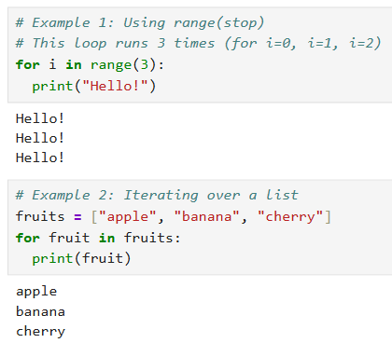
for Loops and range()
What is a for loop? A way to iterate (repeat) a block of code for each item in a sequence (like a list, string, or range).
What is range()? A helper function that generates a sequence of numbers, perfect for loops.
Using range():
  range(stop): Goes from 0 up to (but not including) the stop number.
    range(3) gives 0, 1, 2
  range(start, stop): Goes from the start number up to the stop number.
    range(1, 5) gives 1, 2, 3, 4

Slide 10
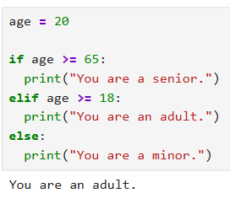
if / elif / else Statements (Decision Making)
What are they? They allow your code to make decisions and run different blocks of code based on conditions.
How they work:
  if: Checks the first condition. If it's True, it runs its code block and skips the rest.
  elif (short for "else if"): If the if was False, it checks this next condition. You can have many elif statements.
  else: If all of the if and elif conditions were False, the else block runs. It's a "catch-all" and is optional.

Slide 11
Conditional & Logical Operators
These are the tools that help you build the "questions" for your if statements.
Conditional (Comparison) Operators: They compare two values.
  == : Equal to (e.g., a == 10)
  != : Not equal to
  > : Greater than
  < : Less than
  >= : Greater than or equal to
  <= : Less than or equal to
Logical Operators: They let you combine multiple conditions.
and: Both must be True.
  Example: Check if a number x is between 10 and 20.
  if (x > 10) and (x < 20):
or: At least one must be True.
  Example: Check if a number x is "outside" the 10-20 range.
  if (x < 10) or (x > 20):
not: Reverses the result (flips True to False and vice versa).
  Example: Check if a number x is not equal to 5.
  if not (x == 5):

Slide 12
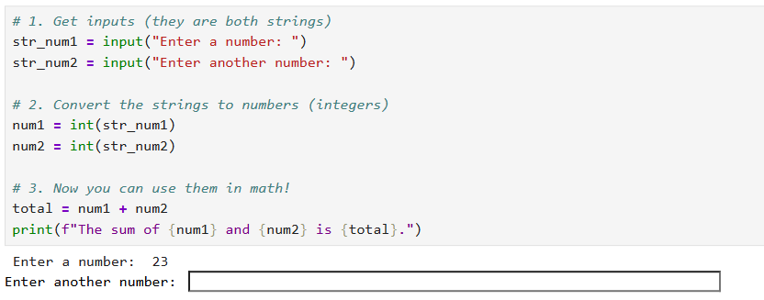

Getting User Input with input()
What is it? The input() function pauses your program and waits for the user to type something, and press Enter.
The Catch: It always returns a string!
  Even if the user types 123, Python sees it as the string "123", not the number 123.
Type Conversion is Essential:
  You must use int() or float() to convert the string to a number if you want to perform math operations.

Slide 13
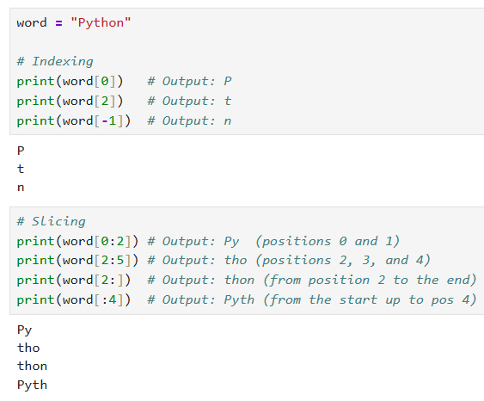
String Indexing & Slicing
What is it? Accessing specific parts of a string using its position, or "index".
Indexing (Accessing one character):
  Python strings are 0-indexed, meaning the first character is at index 0.
  You can also use negative indexes to count from the end (-1 is the last character).
Slicing (Accessing a substring):
  Uses the syntax [start:stop].
  start: The index to begin (inclusive).
  stop: The index to end at (exclusive - it does not include this position).

Slide 14
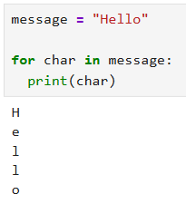
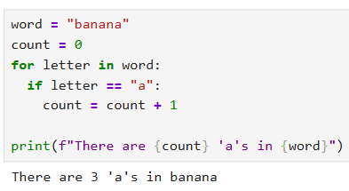
for Loops with Strings
How it works: A string is a sequence of characters, so you can loop over it directly with a for loop.
What it does: The loop will run one time for each character in the string, giving you access to that character.

Slide 15
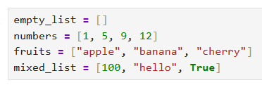
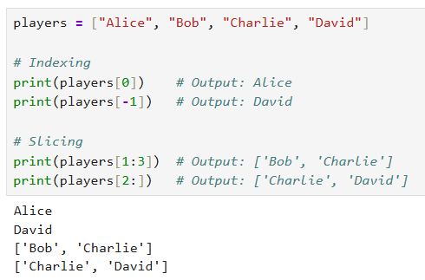
Creating & Accessing Lists
What is a List?
An ordered, changeable collection of items.
Items are inside square brackets [], separated by commas.
Can hold items of any data type, including mixed types.
Accessing Items (Indexing & Slicing):
Just like strings, lists are 0-indexed.
Use [index] to get one item.
Use [start:stop] to get a new list (a "slice").

Slide 16
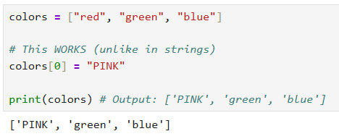
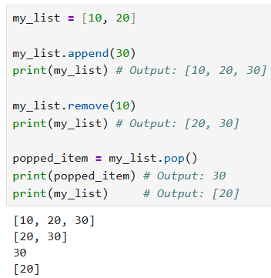
List Mutability & Methods
Changing an Item (by index):
Key Concept: Lists are "Mutable“
Mutable = Changeable.
This is the biggest difference from strings (which are immutable).
You can change, add, or remove items from a list in-place after it has been created.
Example:
Modifying with Methods (in-place):
.append(item): Adds one item to the end of the list.
.remove(value): Removes the first item that matches the value.
.pop(): Removes and returns the item at the end (or at a given index).

Slide 17
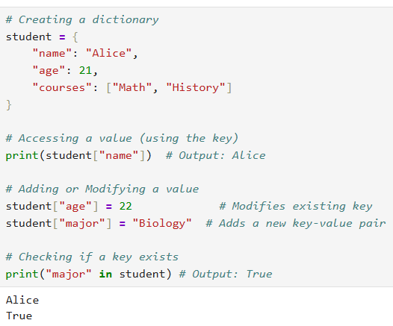
Dictionaries (Key-Value Pairs)
What are they? A collection for storing data as key: value pairs.
Analogy: Think of a real dictionary. The key is the "word" you look up, and the value is its "definition".
Rules:
  Keys must be unique and immutable (strings, numbers, or tuples are fine).
  Values can be anything (lists, other dictionaries, etc.).
Syntax (using {}):

Slide 18
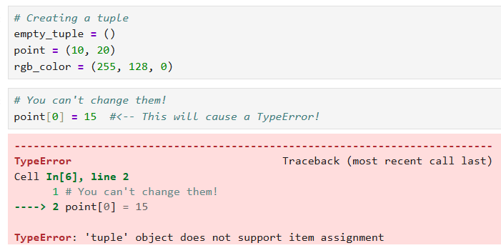
Tuples (Immutable Sequences)
What are they? An ordered, immutable collection of items.
Immutable: This is the key. It means "cannot be changed" once created (just like a string).
Syntax (using ()):

Slide 19
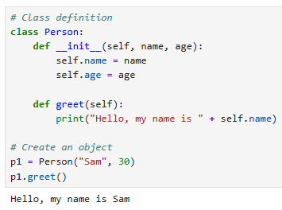
Classes and Instances
What is a Class?
A blueprint for creating objects.
It defines a new, custom data type.
What is an Instance?
An instance is a specific object created from the class blueprint.
Example: p1 instances of the Person class.
In this example, we define a basic Person class with an initialization method (__init__) and a greeting method.

Slide 20
__init__ and self (The Constructor)
What is __init__?
  A special double-underscore method. It's the constructor.
  It runs automatically every time you create a new instance.
  Its job is to initialize the instance's starting data (its "attributes").
What is self?
  self is the most important parameter. It's always the first parameter.
  It refers to the instance itself (e.g., p1).
  We use self.attribute = value to "attach" data to that specific instance.

Slide 21
Methods (Functions in a Class)
What is a Method?
A method is just a function that is defined inside a class.
Methods define the behavior or actions an object can perform.
The first parameter is always self, giving it access to the instance's own data (like self.x).

Slide 22
Data Science Libraries

Slide 23
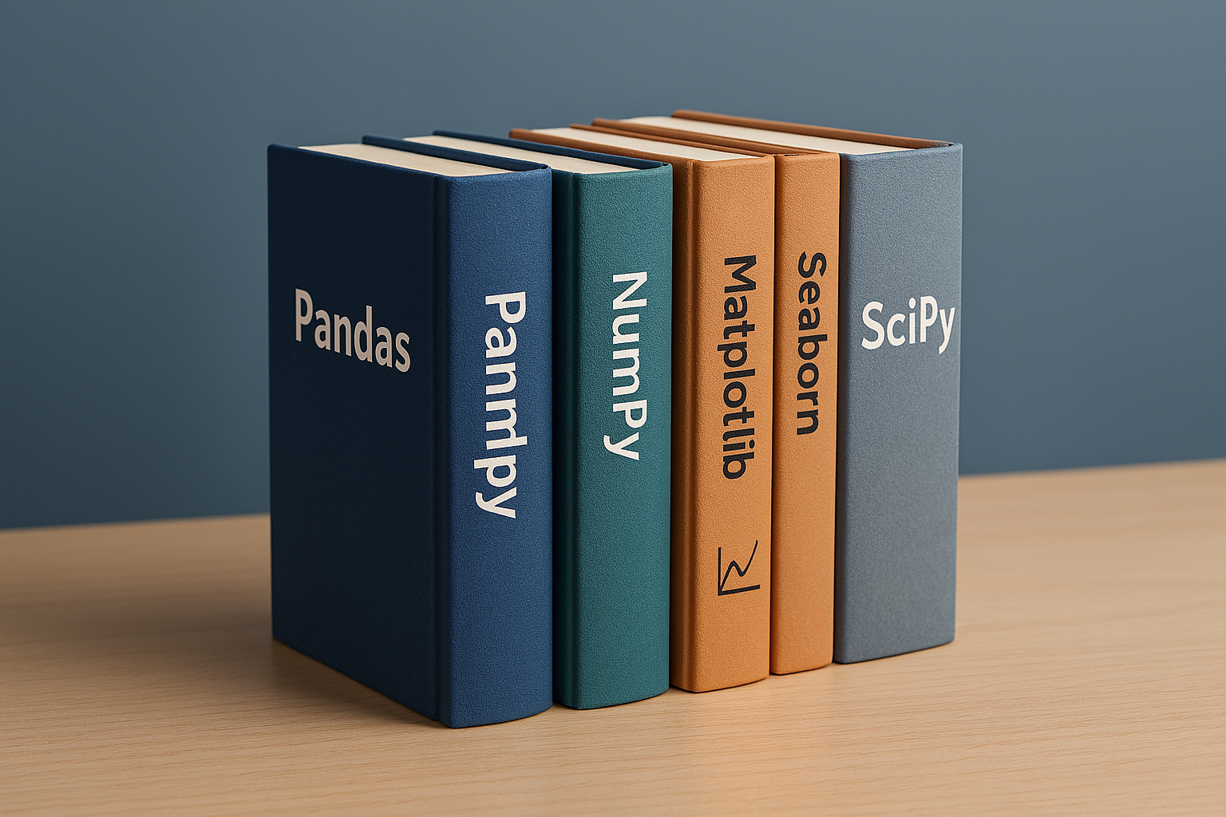
Our Core Libraries
Core Python Libraries
Pandas: Used for data loading, cleaning, and manipulation (DataFrames).
NumPy: The engine for fast numerical computing. Pandas is built on it.
Matplotlib / Seaborn: Our primary libraries for data visualization (plotting).
# Run this cell to install the required libraries
pip install pandas numpy matplotlib seaborn

Slide 24
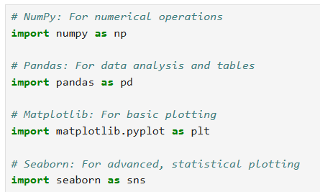
Importing Libraries (The Toolbox)
What is a Library?
  A "toolbox" of pre-written code that adds new functions and features.
  We import libraries to use their tools.
The Standard Imports:
  We use the import ... as ... syntax to give the library a short "nickname" (an "alias").
  This is a universal convention. Everyone uses these aliases.
Note: You only need to import them once at the top of your script or notebook.

Slide 25
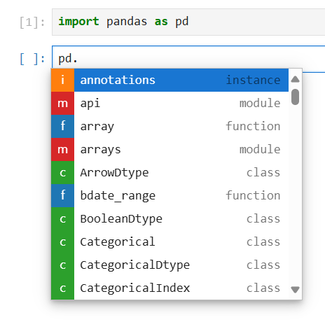
Exploring Libraries: Your Jupyter Assistant
Memorizing every Pandas function is impossible and unnecessary! Jupyter Lab is your best friend for discovery.
How to Explore Any Library (e.g., pandas):
Import the Library:
  import pandas as pd (Run this first!)
Type the Library Alias + Dot:
  pd.
  ...then press TAB

Slide 26
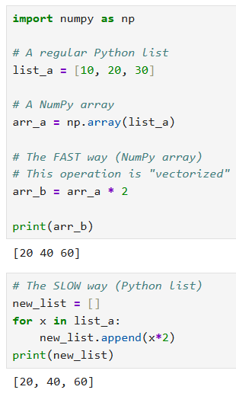
NumPy ndarray
What is it?
  Short for "N-Dimensional Array".
  It's a powerful grid or list, optimized for numbers.
Key Features:
  Homogeneous: All items must be the same data type (e.g., all int64 or all float64). This is what makes it fast.
  Vectorized Operations (Element-wise):
    You can perform math on the entire array at once, without a for loop.
    This is the main reason to use NumPy.

Slide 27
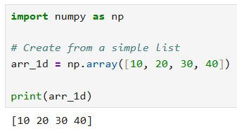
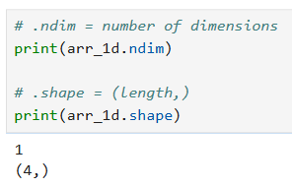
NumPy Arrays: 1D (Vector)
What is it? A single, flat list of elements. It has only one axis (axis 0).
Analogy: Think of it as a single row or a single column in a spreadsheet.
.

Slide 28
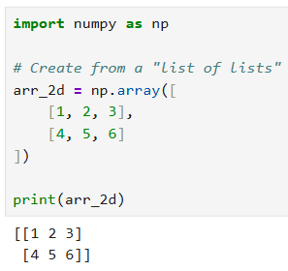
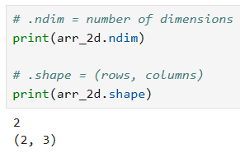
NumPy Arrays: 2D (Matrix)
What is it? A table of elements with rows and columns. It has two axes (axis 0 for rows, axis 1 for columns).
Analogy: A complete spreadsheet, a grid, or a grayscale image.

Slide 29
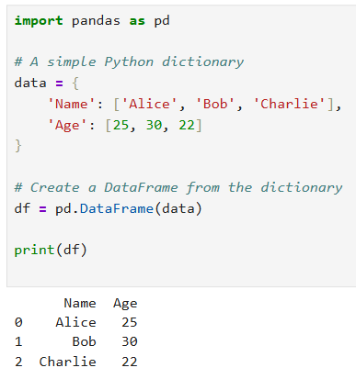
Pandas: Series & DataFrame
What is Pandas?
  A library built on top of NumPy.
  It adds data labels (indexes) to your arrays, turning them into powerful tables.
The Two Core Objects:
  Series (1D):
    A single column of data (like a NumPy array) with an index (labels).
  DataFrame (2D):
    A multi-column table (like an Excel spreadsheet).
    It's a collection of Series objects that share the same index.
    This is the main object you will use 99% of the time.

Slide 30
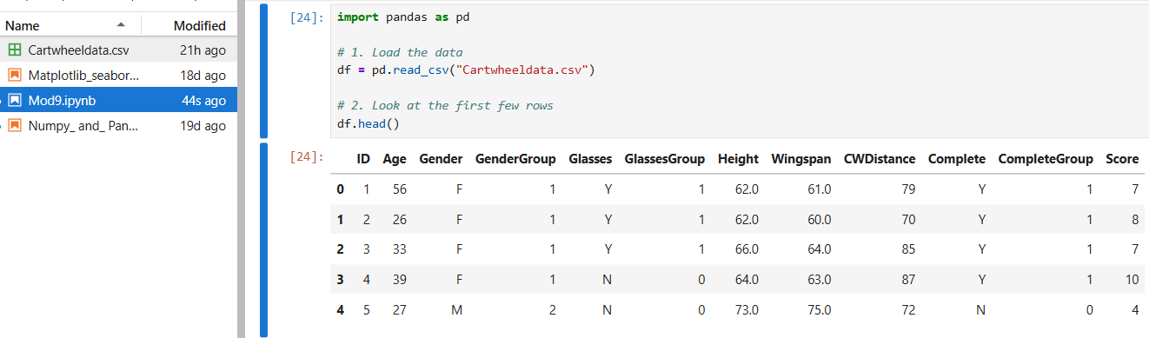
Loading & Inspecting Data (Pandas)
Loading Data:
  The most common way to use Pandas is to read data from a file (like a CSV).
  pd.read_csv() is the most important function to know.
  After loading, always inspect your DataFrame.
  df.head(): Shows the first 5 rows (to make sure it loaded correctly).

Slide 31
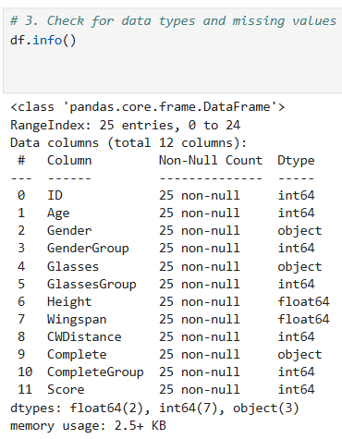
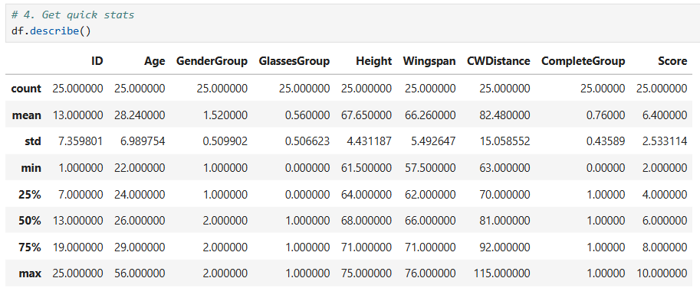
Loading & Inspecting Data (Pandas)
  df.describe(): Shows quick statistics (mean, median, min, max) for numerical columns.
  df.info(): Shows column names, data types (dtype), and missing values.

Slide 32
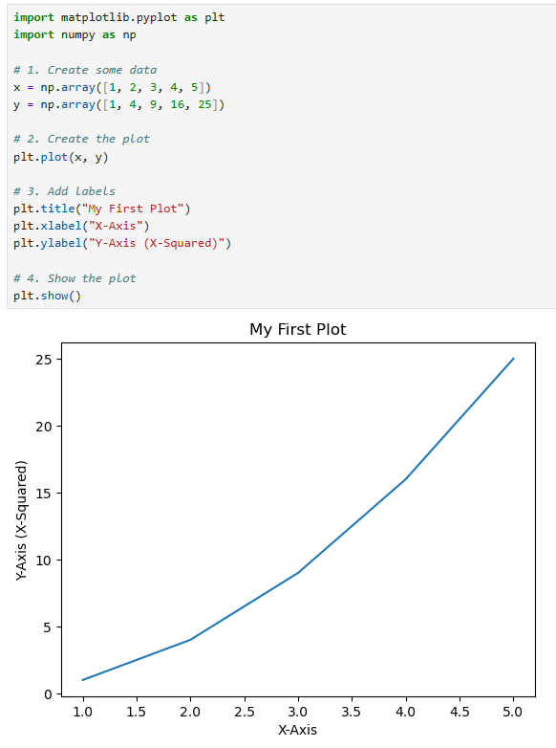
Matplotlib Plotting
What is it? The "go-to" library for creating static plots (line charts, scatter plots, bar charts, etc.). It's the foundation for all other plotting.
The Standard Workflow (plt):
  (Optional) Create a figure: plt.figure(figsize=(10, 6))
  Create the plot: plt.plot(x_data, y_data) (for line plots)
  Add labels: plt.title(), plt.xlabel(), plt.ylabel().
  Show the plot: plt.show()

Slide 33
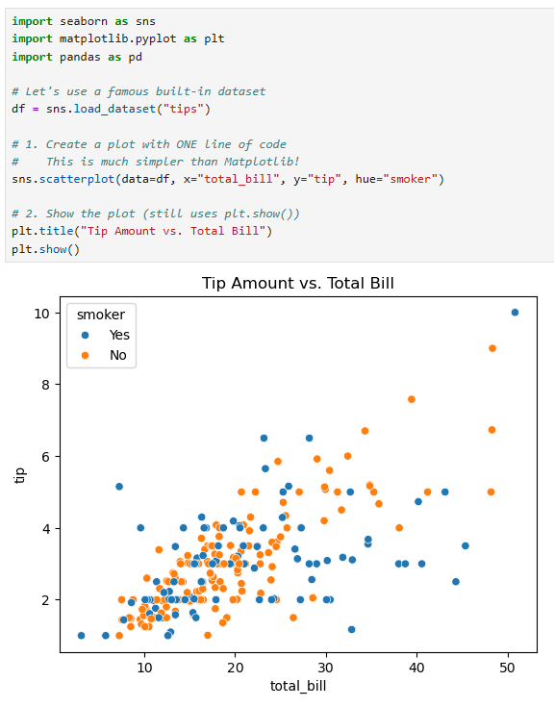
Seaborn (High-Level Statistical Plotting)
What is it?
  A "high-level" plotting library built on top of Matplotlib.
  It's designed to make complex, attractive, and statistically-aware plots (like heatmaps, violin plots, and regression plots) with very little code.
Key Features:
  DataFrame-Aware: It works directly with Pandas DataFrames. You just tell it the column names to use.
  Beautiful by Default: Plots look much better "out of the box".
  Statistical: Great for quickly showing relationships, distributions, and categories.

